Slide 1
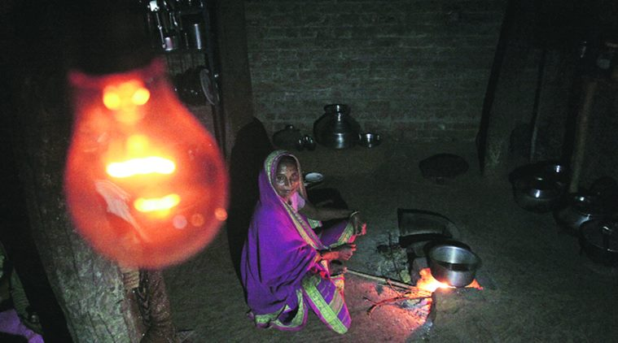
Current Distress
How to define an electrified village?
Case Study - 5
Courtesy: Indian Express
Notes:
Additional Reading Material:
Case study #15, page 104 of the environmental reader textbook
https://www.forbes.com/sites/suparnadutt/2018/05/07/modi-announces-100-village-electrification-but-31-million-homes-are-still-in-the-dark/#381dde6563ba
https://www.bloombergquint.com/global-economics/15-million-indian-households-have-meters-but-no-electricity
https://www.bloomberg.com/news/features/2017-01-24/living-in-the-dark-240-million-indians-have-no-electricity
https://www.asianage.com/india/all-india/290719/despite-govts-claim-many-houses-yet-to-be-electrified.html
https://www.downtoearth.org.in/news/energy/is-100-electrification-another-myth-before-polls--62653
Prepared by: Shaurya Rahul Narlanka

Slide 2
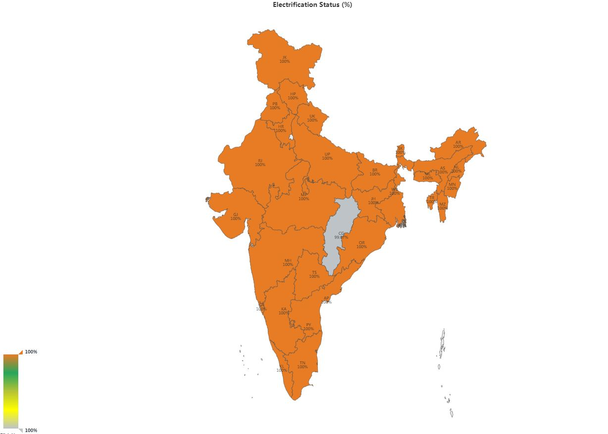
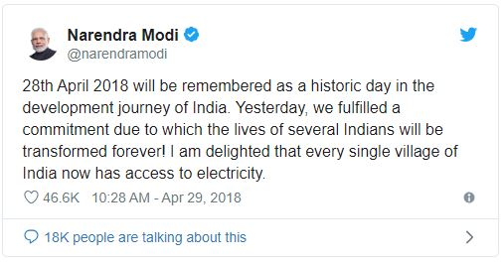
State of Rural Electrification in India
Source: saubhagya.gov.in
Notes:
On 29th April, 2018, the prime minister of India declared that on the 28th, “every single village of India now has access to electricity.” The map in the presentation is from the Ministry of Power’s “saubhagya” website and shows that all states have indeed achieved 100% electrification with the exception of Chhattisgarh whose electrification rate is above 99.67% (hence the grey color) and Delhi, which according to the website, has no households which require electrification.
Source for the India Electrification Status Map: https://saubhagya.gov.in

Slide 3
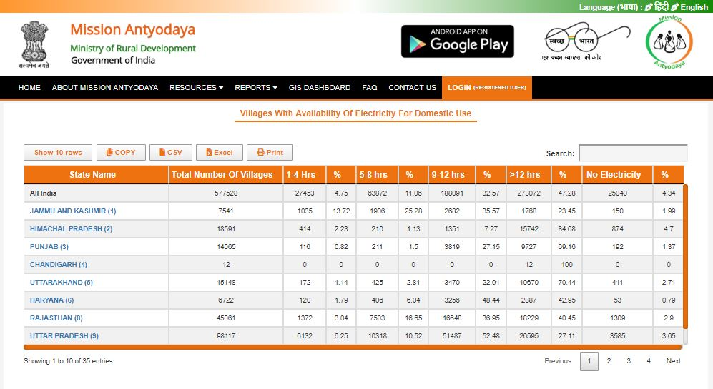
State of Rural Electrification in India
Notes:
But, this number is widely disputed even from within the government. For example, according to a 2018 survey conducted by the Union Rural Development Ministry (URDM), around 25000 villages around India still do not have any access to electricity.
But, keeping aside this discrepancy in the exact number of electrified villages, it is very important to first understand how the government actually defines an electrified village. Because, even if we were to go with the URDM’s claim that roughly 95% of the India’s villages are electrified, it is a very significant achievement towards the universal electrification goal India has strived to achieve since its independence, and should have resulted in a greatly improved quality of life for its rural population. But, as data suggests, even with this level of electrification, India continues to have the largest un-electrified population in the world according to the International Energy Agency (IEA) 2017 data. Therefore, it is important to understand this definition to begin to contemplate why this dichotomy exists and what are its implications.
IEA Data: https://www.iea.org/energyaccess/database/

Slide 4
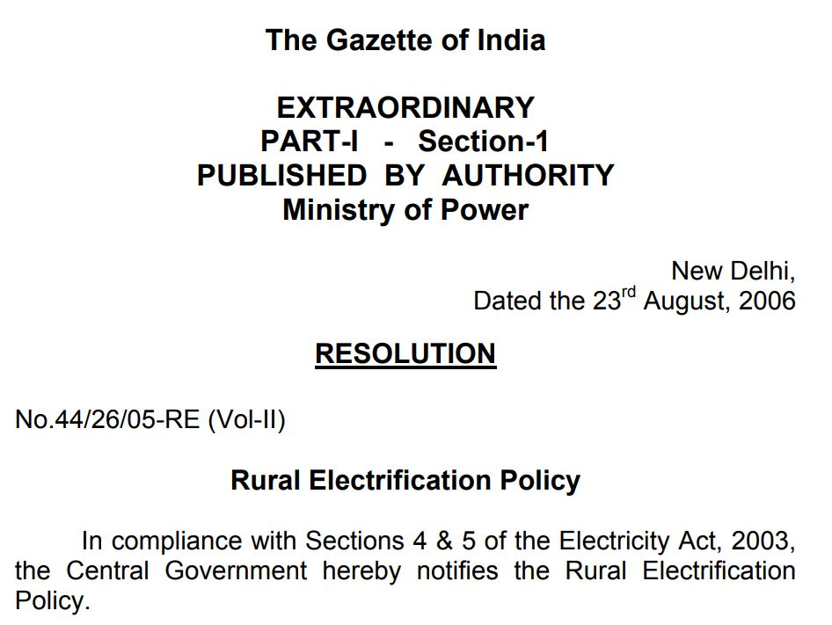
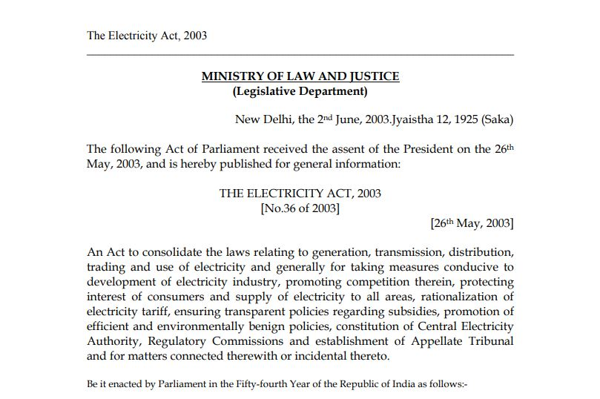
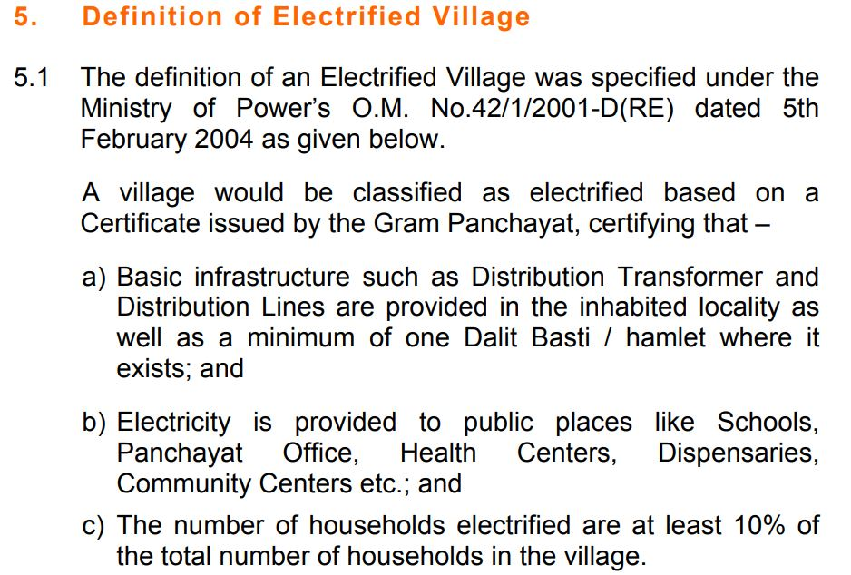
Definition of an electrified village
Notes:
To get to the definition, one has to look the rural electrification policy which was drafted to address the requirements of sections 4 and 5 of the Electricity Act of 2003 (In the act, section 4 is about national policy on stand alone systems for rural areas and non-conventional energy systems and section 5 is about the national policy on electrification and local distribution in rural areas), which defines an electrified village as, among other things, a village whose at least 10% of households have an electric connection. This hypothetically means that 90% of village households in India are still possibly un-electrified. Furthermore, as is evident from URDM’s data, around 50% of the villages in the country get less than 12 hours of electricity a day even when they have an electric connection.
Therefore, the issue of rural electrification in India is two pronged. The first is actually providing the rural population of the country access to electricity. This is still a daunting task as many of the remaining villages are remote, and the upfront cost of installing an electric connection is out of the scope of many villagers. Adequate subsidies need to be provided to make the connection viable for such households. Second, is to provide a good quality electric connection. This means having an almost round-the-clock electric connection with enough voltage to power basic equipment like fans, lights etc. in a household.

Slide 5
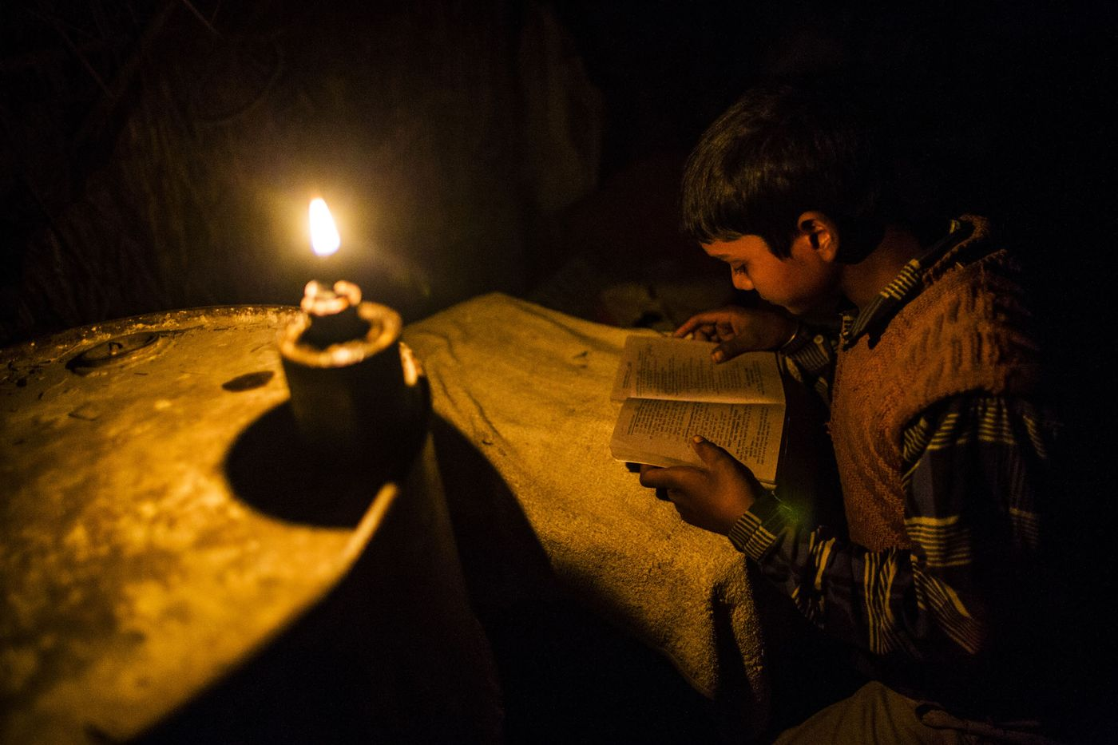
Implications
Kerosene and biomass usage
Poor indoor air quality
Fire related accidents and deaths
Increase in overall health burden especially for women and children
Poor overall productivity
Source: Bloomberg
Notes:
The implications of not having universal basic electrification across the country can be mainly contributed to continued usage of kerosene and/or biomass as the primary fuel for lighting. These are fuels which release a lot of residue upon burning and lead to poor indoor air quality. This increases the overall health burden of the household and especially for the women and children of the household. This ultimately leads to poor productivity and therefore poor quality of life of the household. There is also an increased chance of fire related deaths and accidents as a consequence of using these fuels.

Slide 6
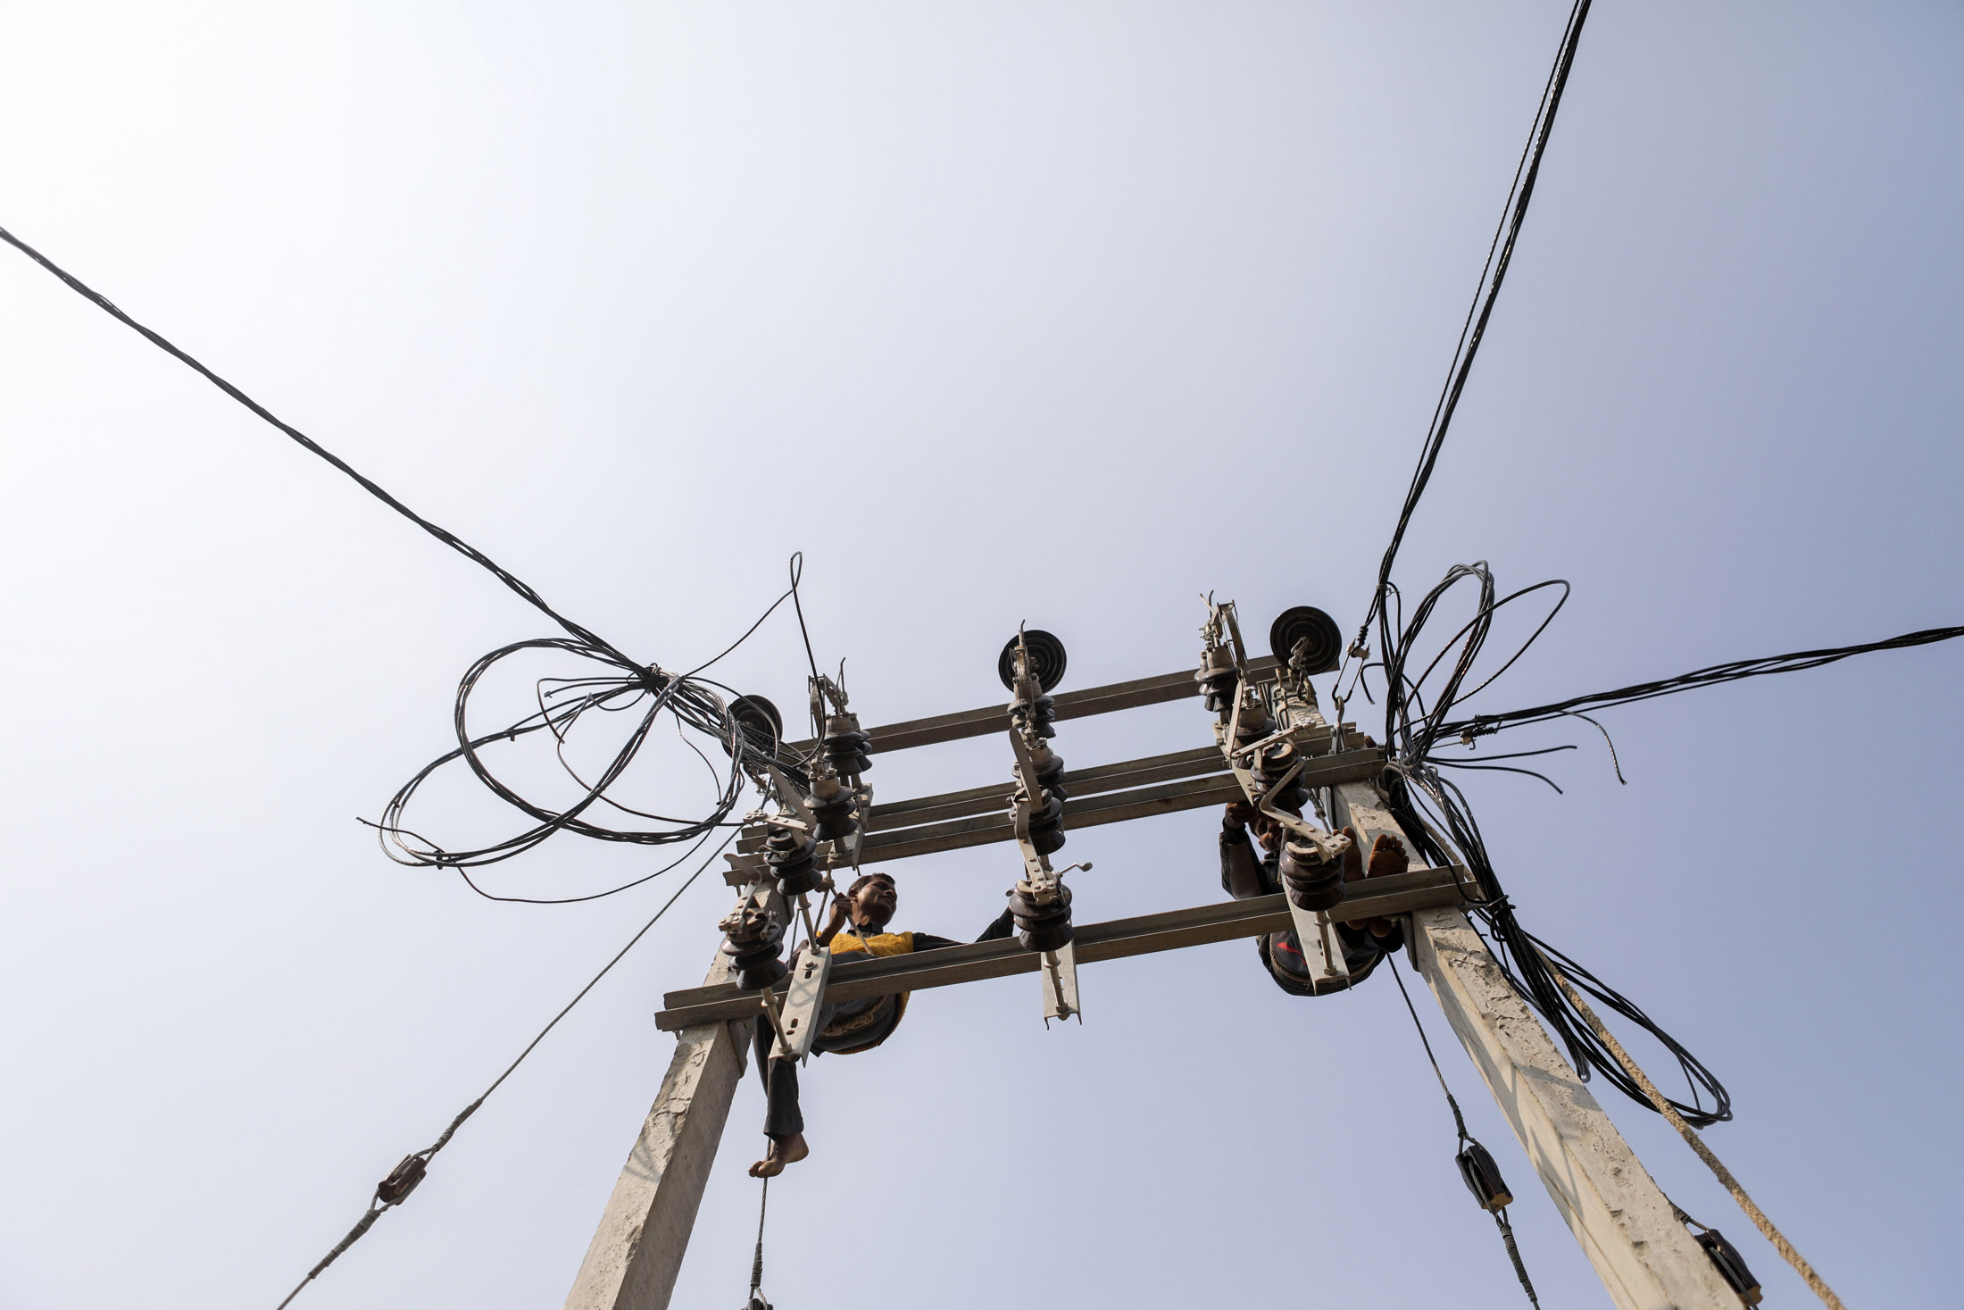
Solutions
Expansion and interconnection of electric grids in the country
Installation of decentralized mini-grids powered by renewable energy
Upgrade grid to minimize losses
Tighter control on electricity theft
Source: Bloomberg

